Slide 1

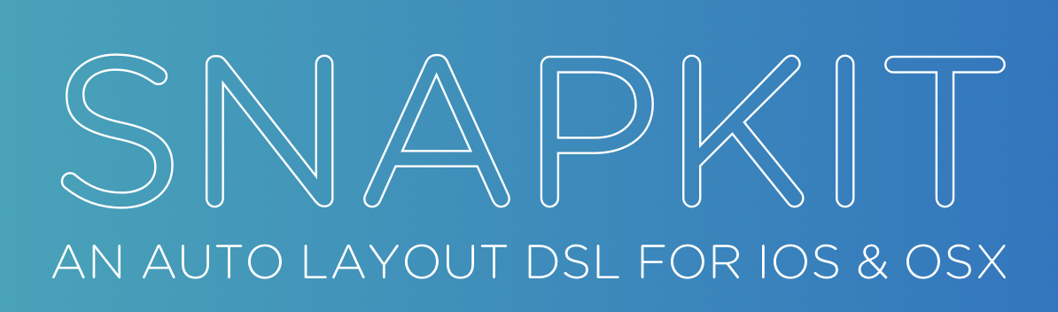
SnapKit vs Texture
Thursday, 2 Juny 2022
By Galang A S

Slide 2
Why we need to building UI use programmatically?
No more conflicts in XIB file
Performance wise. XIB needs to be read from the disk and analysed/parsed
XIBs lack customizations (drop shadows, round corners)

Slide 3
How to Build Programmatically UI?
UIKit only
Uikit + Snapkit
AsyncDisplayKit / Texture
SwiftUI
FluentUI (Microsoft Fluent UI design system)

Slide 4
What is SnapKit?
Lightweight DSL (domain-specific language) to make Auto Layout and constraints a breeze to work with.
A domain-specific language (DSL) is a language created to express and deal with a specific domain or to solve a specific problem.

Slide 5
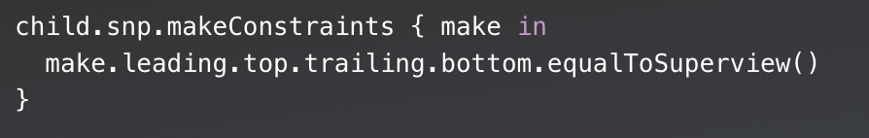
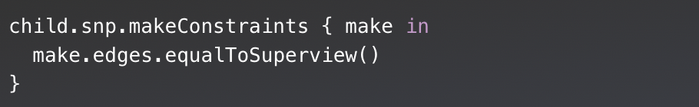
what snapkit can do?
Composability and Chaining
=

Slide 6
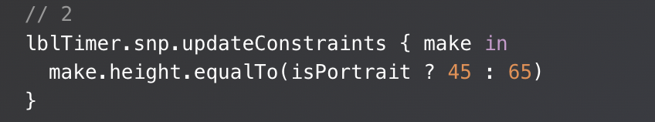
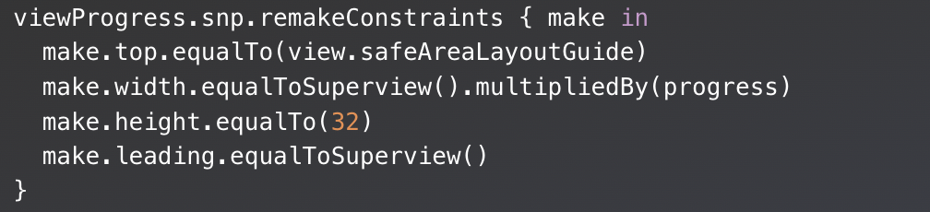
What snapkit can do?
Modify Constraints

Slide 7
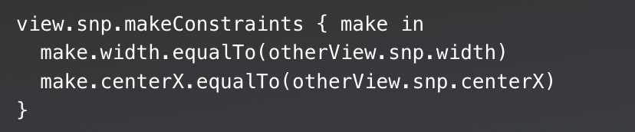
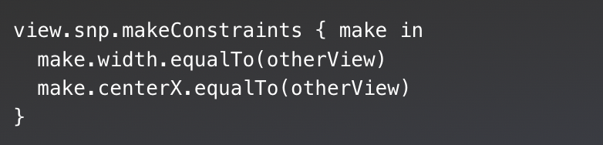
What snapkit can do?
No Specificity Needed
=

Slide 8
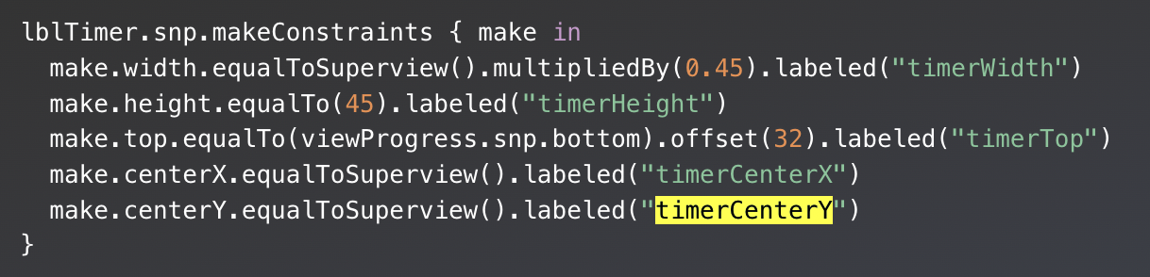
What snapkit can do?
Debug with ease

Slide 9
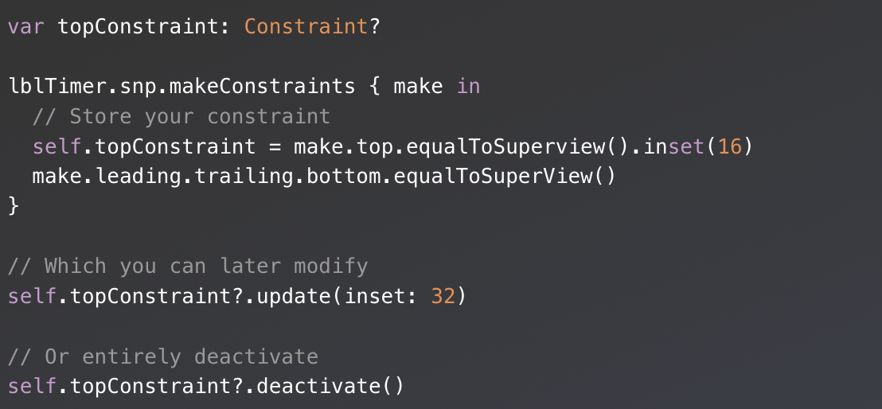
What snapkit can do?
Keeping a reference

Slide 10
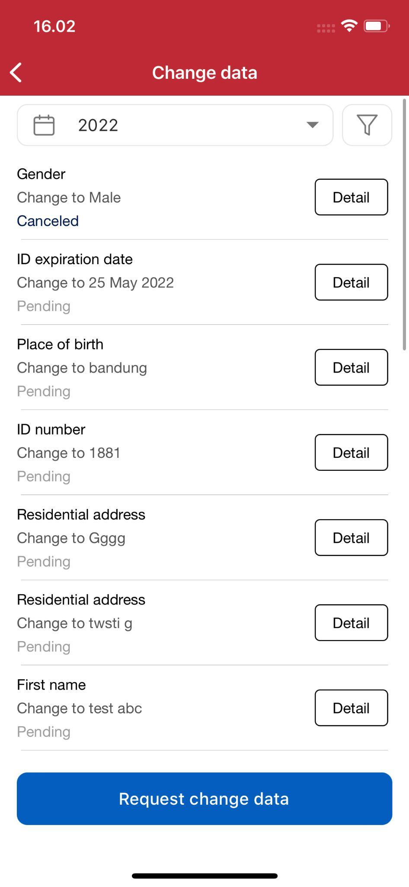
Sample Project

Slide 11
Pros and Cons of Using Snapkit
Pros:
Syntax that is much more intuitive and easy-to-use.
Lots of tutorials.
Cons:
Still need basic knowledge of Auto layout and Constraints.

Slide 12
What is Texture?
Texture is an iOS framework built on top of UIKit that keeps even the most complex user interfaces smooth and responsive.
Originated at facebook in 2014
Currently maintained by Pinterest

Slide 13
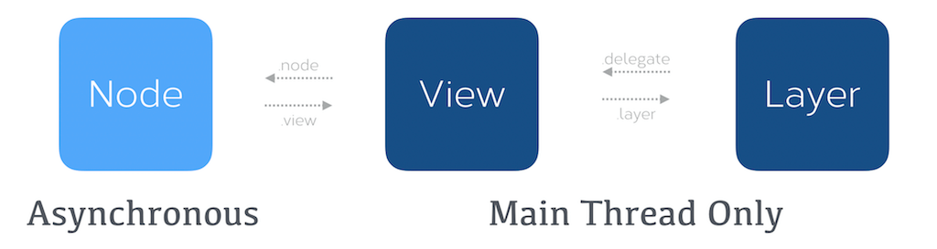
Main Concept
“ Everything is a Node “

Slide 14
Custom Object
ASDisplayNode
ASImageNode
ASButtonNode
ASMapNode
ASTextNode
ASNetworkImageNode
ASEditableTextNode
ASControlNode

Slide 15
Layout Spec
ASWrapperLayoutSpec
ASStackLayoutSpec
ASInsetLayoutSpec
ASOverlayLayoutSpec
ASBackgroundLayoutSpec
ASCenterLayoutSpec
ASRatioLayoutSpec
ASRelativeLayoutSpec
ASAbsoluteLayoutSpec
ASCornerLayoutSpec

Slide 16
Sample Project

Slide 17
Pros and Cons of Using Texture
Pros:
Better Performance.
Well Documented.
No more auto layout issue.
Straightforward.
Cons:
Learn something new concept.
Relatively difficult to learn for new developers.

Slide 18
Conclusion
Snapkit and Texture have different purposes.
Snapkit was built to make Auto Layout and constraints easy to use, more intuitive and expressive. Texture was built related to performance to make iOS UI more smooth and responsive.
Should we use snapkit or texture ? Back to needs and resources ;)

Slide 19
Resource:
https://codewithchris.com/xcode-using-storyboards-and-xibs-versus-creating-views-programmatically/
https://www.raywenderlich.com/3225401-snapkit-for-ios-constraints-in-a-snap
https://snapkit.github.io/SnapKit/docs/
https://texturegroup.org/docs/getting-started.html
https://www.youtube.com/watch?v=7tH1CproXPg&list=WL&index=1

Slide 20


